Slide 1
VAIDYA: HEALTH CARE CHATBOT
Submitted in the partial fulfillment for the award of the degree of
BACHELOR OF ENGINEERING
IN
COMPUTER SCIENCE ENGINEERING WITH SPECIALIZATION IN ARTIFICIAL INTELLIGENCE AND MACHINE LEARNING
Submitted by:
RHYTHM GOEL - 19BCS6094 (Team Leader)
RATNESH PURI - 19BCS6082
SOMESH TOTLANI - 19BCS6085
RAHUL BANSAL - 19BCS6087
PARV ARORA - 19BCS6088
Under the Supervision of:
Prof. DINESH VIJ
Department of AIT-CSE
DISCOVER . LEARN . EMPOWER

Slide 2
Outline
Introduction to Project
Problem Formulation
Objectives of the work
Methodology used
Results and Outputs
Conclusion
Future Scope
References

Slide 3
Introduction to Project
Problem definition:
Healthcare is very important to lead a good life. Normally Users are not aware of all the treatment or symptoms regarding the particular disease. For small, problem users have to go personally to the hospital for a check-up which is more time-consuming and it is very difficult to obtain a consultation with the doctor for every health problem immediately.
Such a problem can be solved by using a medical Chatbot by giving proper guidance regarding healthy living. The idea is to create a medical chatbot using Neural Networks that can diagnose the disease and provide basic details about the disease and whether and when to consult a doctor.

Slide 4
Introduction to Project
Problem overview/specifications:
We decided to develop a computer system to establish communication between humans and a computer by using natural language processing (NLP). The main purpose of this scheme is to remove the language gap between the user and health providers by giving immediate replies to the Questions asked by the user.
A Chatbot is an Entity that imitates human discussion in its particular accepted set-up together with a text or vocal language with techniques such as Natural Language Processing (NLP).
Our motive is to show that the proposed medical Chatbot could be a better alternative to many already existing Chatbots in the domain of medicine.

Slide 5
Problem Formulation
In the current world situation, people are more concerned about their health. Unfortunately, nowadays the doctor human resource is lesser than the patient. These circumstances make a lot of people who seek treatment are unhandled.
A Chatbot is a system that can interact with human users with natural language. Chatbots provide accurate and efficient information based on the user’s requirements.
The use of natural language processing (NLP) methods and their application to developing conversational systems for health diagnosis increases patients’ access to medical knowledge.
We want to explore and deepen more about chatbots that could help people to get the same and proper treatment as a doctor would do. The system will be able to measure the seriousness of the diagnosis and if needed, it will connect the user to a doctor available online.

Slide 6
Objectives
In this proposed project of Healthcare Chatbot, we are going to build a chatbot using python language and some deep learning techniques. The information will be used to train the chatbot, which will include categories (intents), patterns, and replies.
We'll classify the user's message using a specific recurrent neural network, and then select a random answer from a selection of options, also chatbot will be able to identify similar type of question based on pattern, information and training dataset, furthermore we will use Natural Language Processing Techniques (NLTK), Pytorch etc. libraries in order to make the chatbot system and Tkinter module for GUI purpose.

Slide 7
Methodology Used
a) Dataset Preparation: Create a JSON- file with a defined structure: ​
i) Tag (unique name)​
ii) Patterns (The neural network will be trained on sentence patterns) ​
iii) Responses (Once our model recognizes what tag and pattern a user input belongs to, it will return the respective response). This JSON- file is the training data for our model. The more input the JSON- file gets, the better and more reliable the final chatbot will be. ​

Slide 8





















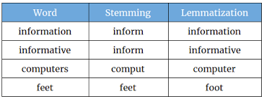
Methodology Used (Cont..)
b) Data Processing: After creating the customized JSON- file, it's time to preprocess the data. In our case, we have to do, Word Stemming and create a Bag of Words. In Natural Language Processing (NLP), Word Stemming is the process to reduce a word to its root/base.
Since Machine Learning Algorithms do not understand textual data and require numerical input, we use the Bag of Words approach to meet these requirements so that texts can be converted to numeric vectors. ​

Slide 9
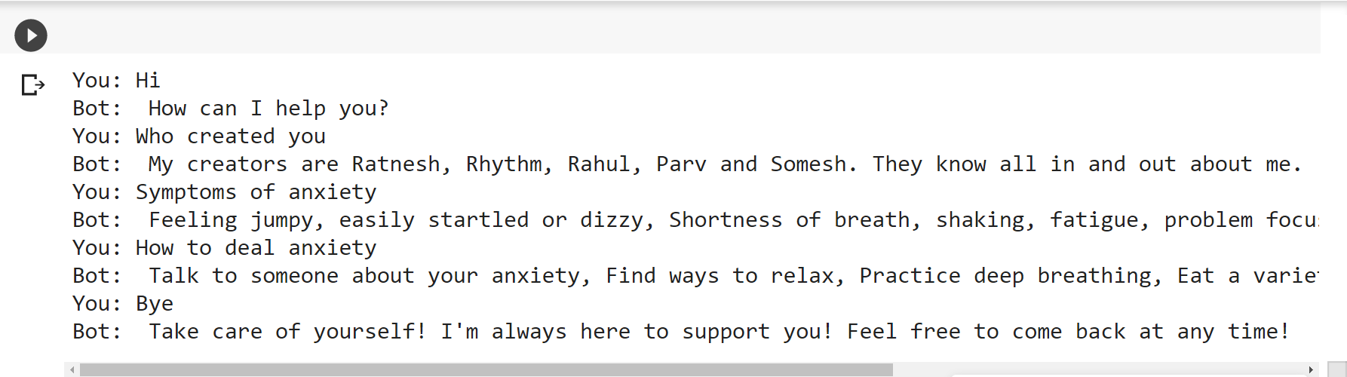
Methodology Used (Cont..)
c) Model Building: After the preprocessing part is completed, we have to build and train our model. Here, we will use a neural network with hidden layers. ​
Fig: Bot conversation after training of model

Slide 10
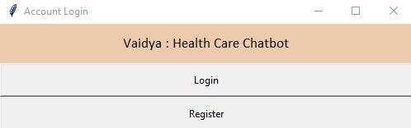
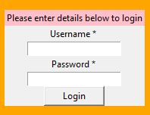
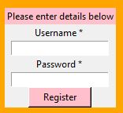
Result and Outputs
Fig: Home Screen
Fig: Login Page
Fig: Registration Page

Slide 11
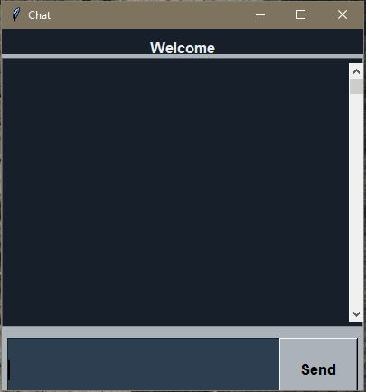
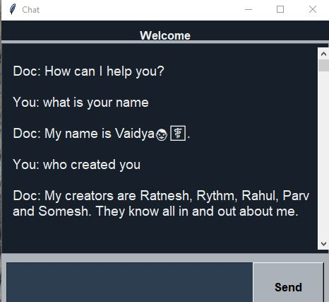
Fig: Chat Window
Fig: Example of conversation with BOT

Slide 12
Conclusion
Chatbot is a great chat tool. Here the application is designed to provide short-term feedback. It relieves the burden on the feedback provider by directly delivering feedback to the user using the expert system. This project is designed for the user to save the users time by consulting a doctor or specialist about a health solution.
User can find related feedback displayed, then refer this answer to the analysis. The advantage of chatbots is that they carry a visible Doctor in their pockets. It can also give them the freedom to consult a doctor 24/7.

Slide 13
Future Scope
Medical information is very important and should not be so disclosed to anyone. Thus, a more secure system could be made.
A system that can not relay information about a disease but also be able to tell a diagnosis based on symptoms provided.
To reduce the difficulty of texting, concept of voice-based conversation can also be developed.
Providing patients, the facility to upload their medical documents is also a feature that can be added.

Slide 14
References
Comendador, B. E., Francisco, B. M., Medinilla, J. S., Nacion, S. M., & Serac, T. B. (2015). Pharmabot: A Pediatric Generic Medicine Consultant Chatbot. Journal of Automation and Control Engineering, 3(2), 137-140.doi:10.12720/joace.3.2.137-140.
Kazi, Hameedullah & S. Chowdhry, B & Memon, Zeesha. (2012). MedChatBot: An UMLS based Chatbot for Medical Students. International Journal of Computer Applications. 55. 1-5. 10.5120/8844-2886.
Novel Approach for Medical Assistance Using Trained Chatbot”, Divya Madhu, Neeraj Jain International Conference on Inventive Communication and Computational Technologies.
Emanuela Haller, Traian Rebedea Faculty of Automatic Control and Computers university Politehnica of Bucharest, 978-0-7695-4980-4/13 $26.00 ©️ 2013 IEEE. "Designing a Chat-bot that Simulates a Historical Figure"
Imran Ahmed and Shikha Singh"AIML Based Voice Enabled Artificial Intelligent Chatterbot”, International Journal of u-and e-Service, Science andTechnology Vol.8, No.2 (2015)
Bayu Setiaji, Ferry Wahyu Wibowo, Department of Informatics Engineering STMIK AMIKOM Yogyakarta, Yogyakarta, Indonesia, 2166-0670/16 $31.00 ©️ 2016 IEEE "Chatbot Using A Knowledge in Database-Human-to-Machine Conversation Modeling".
V. Manoj Kumar"Sanative Chatbot For Health Seekers”, JECS Volume 05 Issue 3 March 2016 Page No.16022-16025.
Imran Ahmed and Shikha Singh"AIML Based Voice Enabled Artificial Intelligent Chatterbot”, International Journal of u-and e-Service, Science and Technology Vol.8, No.2 (2015).

Slide 15
References
https://www.researchgate.net/publication/346474932_Medical_Chatbo t_Techniques_A_Review View at: Publisher Site | Google Scholar
https://www.researchgate.net/publication/326469944_Automated_Me dical_Chatbot View at: Publisher Site | Google Scholar
Research Journal: https://www.irjet.net/archives/V7/i11/IRJET-V7I11283
S. Anil Kumar, C. Vamsi Krishna, P. Nikhila Reddy, B. Rohith Kumar Reddy,
I. Jeena Jacob. (2020). Self-Diagnosing Health Care Chatbot using Machine Learning. International Journal of Advanced Science and Technology, 29(05), 9323-9330. Retrieved from http://sersc.org/journals/index.php/IJAST/article/view/19027
Nadarzynski T, Miles O, Cowie A, Ridge D. Acceptability of artificial intelligence (AI)-led chatbot services in healthcare: A mixed-methods study. DIGITAL HEALTH. January 2019. doi:10.1177/20552076198718
Sophia, J.J., Kumar, D.A., Arutselvan, M., Ram, S.B.: A survey on chatbot implementation in health care using NLTK. Int. J. Comput. Sci. Mob. Comput. 9(2020) Link: https://www.researchgate.net/publication/346474932_Medical_Chatbo t_Techniques_A_Review
Raj, P., Murali Krishna, R., Krishna, S.M., Vardhan, K.H., Rao, K.: Emergency patient care system using chatbot. Int. J. Technol. Res. Eng. 6(2019) Link: - https://link.springer.com/chapter/10.1007%2F978-3-030-63322-6_28
KC, G.P., Ranjan, S., Ankit, T., Kumar, V.: A personalized medical assistant chatbot: Medi Bot. Int. J. Sci. Technol. Eng. 5(7) (2019) Link: https://link.springer.com/chapter/10.1007%2F978-3-030-63322-6_28

Slide 16
References
Sagar Badlani, Tanvi Aditya, Meet Dave, Sheetal Chaudhari, "Multilingual Healthcare Chatbot Using Machine Learning", Emerging Technology (INCET)2021 2nd International Conference for, pp. 1-6, 2021.
Siddhant Meshram, Namit Naik, Megha VR, Tanmay More, Shubhangi Kharche, "Conversational AI: Chatbots", Intelligent Technologies (CONIT) 2021 International Conference on, pp. 1-6, 2021.
S Swathi, E Saranya, R.M. Prabakaran, M Sachin Kumar, S Bairavel, "Virtual Health Assistant", System Computation Automation and Networking (ICSCAN) 2021 International Conference on, pp. 1-4, 2021.
W. Astuti, D. P. I. Putri, A. P. Wibawa, Y. Salim, Purnawansyah and A. Ghosh, "Predicting Frequently Asked Questions (FAQs) on the COVID-19 Chatbot using the DIET Classifier," 2021 3rd East Indonesia Conference on Computer and Information Technology (EIConCIT), 2021, pp. 25-29, doi: 10.1109/EIConCIT50028.2021.9431913.
R. B. Mathew, S. Varghese, S. E. Joy and S. S. Alex, "Chatbot for Disease Prediction and Treatment
Recommendation using Machine Learning," 2019 3rd International Conference on Trends in Electronics and Informatics (ICOEI), 2019, pp. 851-856, doi: 10.1109/ICOEI.2019.8862707.
Available from: https://medicalfuturist.com/top-12-health-chatbots/ [accessed 16 Sept 2021].
Available from: https://research.aimultiple.com/chatbot-healthcare/[accessed 19 Sept 2021].
Available from: https://www.engati.com/blog/chatbots-for-healthcare /[accessed 24 Sept 2021].

Slide 17
THANK YOU

